Slide 1
Introduction to Statistics

Slide 2
Roadmap to Statistics
If you want to make career in following courses:
Data Analyst
Data Scientist
Power BI,Tableu
Business Analyst

Slide 3
Statistics
Statistics is a mathematical body of science that pertains to the collection, analysis, interpretation or explanation, and presentation of data, or as a branch of mathematics.
In other words, it is a mathematical discipline to collect, summarize data.
Statistics is all about is converting data into useful information.

Slide 4
Types of Statistics
Basically, there are two types of statistics.
Descriptive Statistics
Inferential Statistics

Slide 5
Types of Statistics
Descriptive Statistics(Summarizing,analyzing and visualizing data)
Measure of Central Tendency
Measure of Dispersion
Correlation-variance
Univariant, bivariate analysis
Graphs:Boxplot,histogram etc.
Inferential Statistics(Using data you have measure to form conclusion)
Hypothesis Testing

Slide 6
What is population?
In statistics, population is the entire set of items from which data is drawn for a statistical study.
It can be a group of individuals, a set of items etc. It constitutes the pool for a study.
The process of statistics starts when we identify what group we want to study or learn something about. We call this group the population.

Slide 7
What is Sample?
A sample represents the group of interest from the population which we will use to represent our data.
The sample is subset of the population which best represents the whole data.

Slide 8
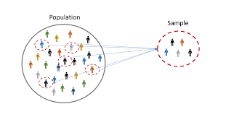
Population and Sample

Slide 9


Slide 10
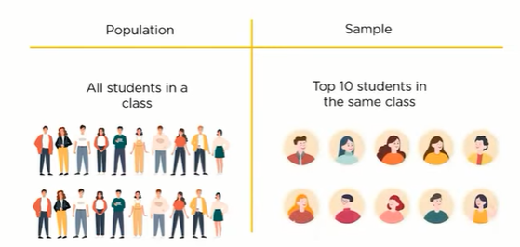

Slide 11
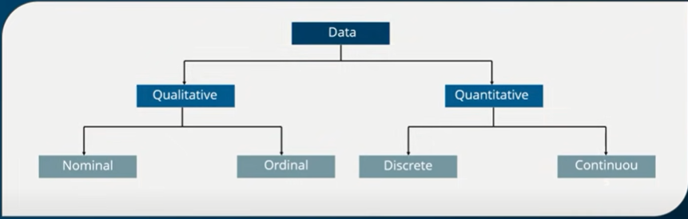
What is Data in Statistics?

Slide 12
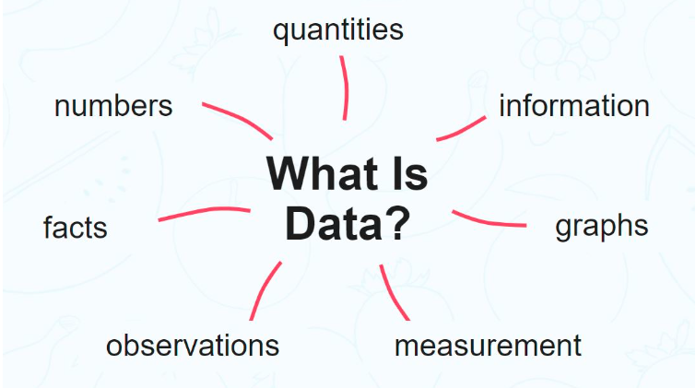

Slide 13
Types of Data
Qualitative data- It is descriptive data.
Qualitative data deals with characteristics and descriptors that can’t be easily measured,but can be observed subjectively.
2.Quantitative data- It is numerical information.
Quantitative data deals with numbers and things you can measure objectively.

Slide 14
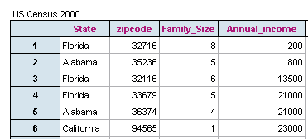
Example

Slide 15
Basics of Statistics
The basics of statistics include the measure of central tendency and the measure of dispersion.
The central tendencies are mean,median and mode and dispersions comprise variance and standard deviation.

Slide 16
Sampling technique
The goal of sampling is to create a sample that is representation of the entire population.
Types of Sampling:
Simple Random Sampling
Stratified Sampling
Systematic Sampling
Convenience Sampling(Volentary Response Sampling)

Slide 17
Simple Random Sampling
When performing simple random sampling every member of the population(N) has an equal chance of being selected for your sample(n).
Stratified Sampling
Stratified sampling is layering where non overlapping groups are generated.
Example:
Population is divided into Male group and Female Group

Slide 18
Systematic Sampling
In Systematic sampling, every nth record is chosen from the population to be a part of the sample.

Slide 19

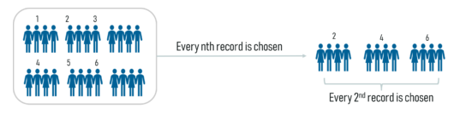
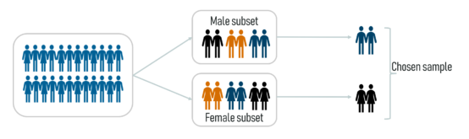
Random Sampling
Systematic Sampling
Stratified Sampling

